Slide 1
Design of a Decision System for Topic Prediction from News Titles
Nihar Sudhanshu Limaye
Student Number :- 18210876
Email :- nihar.limaye3@mail.dcu.ie
Supervisor: Dr. Yvette Graham
Email: yvette.graham@computing.dcu.ie
^{3rd Sept 2020}

Slide 2
Project Motivation
Huge volume of news available on web
Data management has a cost
Need a way to automatically categorize a news title
Natural Language Processing (NLP) can be used
Numerous techniques available for classifying news title using machine learning (ML)
Finding best possible pair of word embedding & ML classifier is necessary

Slide 3
Need of Topic Prediction
Why do we need a system to predict news topic in the real world?
Many online sources generate immense amounts of daily news
Demand has increased
Classification required for accessing news quickly and effectively
How Topic Prediction can be handled?
Machine learning classifiers can be used
Feature selection method can be applied to assist classification
Challenges?
News title length varies
Complexity increases with increase in corpus size

Slide 4
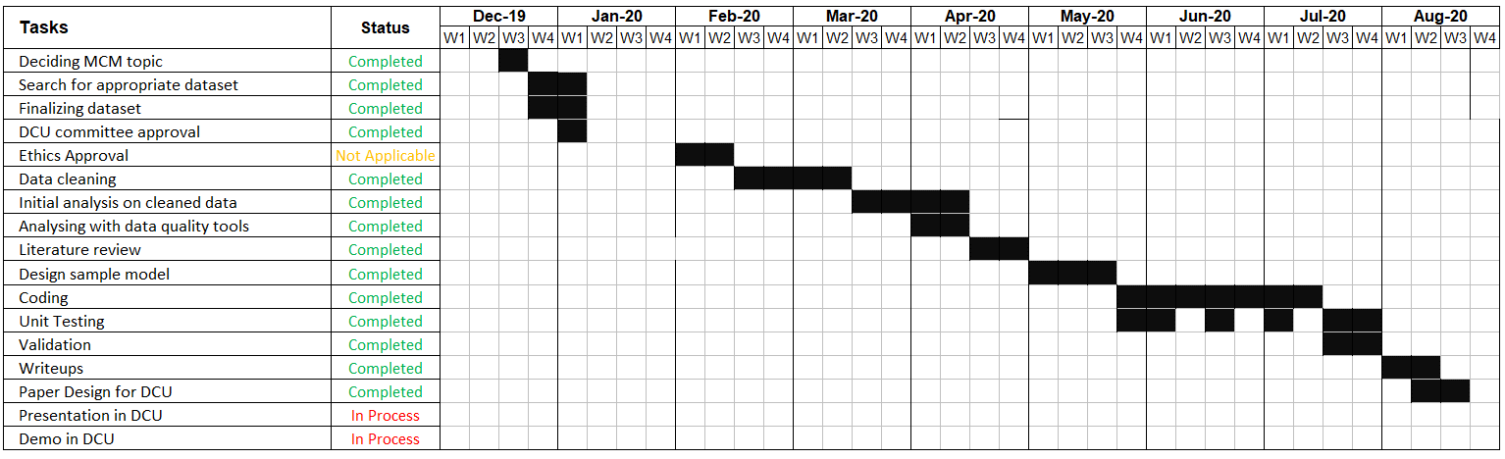
Project Timeline

Slide 5
Dataset
News Aggregator dataset [11] comprises of 422,937 news titles
Four different topics (labels) namely technology, business, health, and entertainment
Dataset is biased having imbalance number of records amongst categories
Method applied to pick random 45,639 records in each new execution
Category Name | Records
Technology | 152,462
Business | 115,964
Entertainment | 108,341
Health | 45,639
Category Name | Records
Technology | 45,639
Business | 45,639
Health | 45,639
Entertainment | 45,639
Table 1. Biased dataset
Table 2. Un-Biased dataset
[11] UCI News Aggregator UCI Machine Learning Repository: News Aggregator Data Set

Slide 6
Research Questions
1. How efficiently trained ML models can predict the news categories by analysing news titles?
2. Can prediction-based word embeddings improvise the result over traditional frequency-based embeddings?

Slide 7
Introduction
What are Frequency based embeddings?
Count number of occurrences of a word in a sentence to make vocabulary
Eg. Document 1: “The cat sat on the hat”
Document 2: “The dog ate the cat and the hat”
From these two documents, our vocabulary is as follows: { the, cat, sat, on, hat, dog, ate, and} so D = 2, T = 8
What are Prediction based embeddings?
Is learning to predict the word by the context
Eg: “The cat jumped over the puddle.”
So one approach is to treat {“The”, “cat”, ’over”, “the’, “puddle”} as a context and from these words, be able to predict or generate the center word “jumped”

Slide 8
Literature Review
Reference | Literature Paper Title | Takeaway
Bogery, R et al.[6] | Automatic Semantic Categorization of News Headlines using Ensemble Machine Learning | 1. To preserve context of the word 2. Reduction of vector dimensionality
Akritidis, L et al.[5] | A Self-Pruning Classification Model for News articles | Bag of words (BOW) technique with supervised classification method N-gram word method used with word tokens
Al-Tahrawi et al. [7] | Arabic Text Categorization Using Logistic Regression | LR used as one of the ML classifier Text cleaning techniques
Stein, R et al. [14] | An analysis of hierarchical text classification using word embeddings | Use of FastText & Word2Vec embeddings for feature selection
Asy'arie, A.D et al. [2] | Automatic news articles classification in the Indonesian language by using naive bayes classifier method | Naïve Bayes Classifier is used as one of the classifier for English news Case folding method

Slide 9
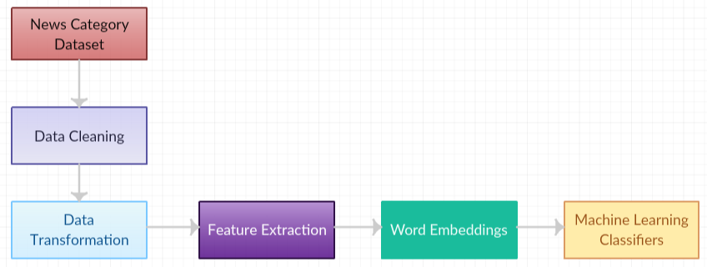
Design of a System
Fig 1. Blocks of System

Slide 10
System Components
Blocks | Components
Data Cleaning | Data formatting | Removal of duplicates | Removal of blank/missing entries | -
Data Transformation | Tokenization | Stop Word removal | Label Encoding | Lemmatization
Feature Extraction | Number of words | Column Merge | Sequence Padding | -
Word Embedding | Frequency-based embedding | Prediction based embedding | - | -
Machine Learning Classifier | Naive Bayes (NBC) | Logistic regression (LR) | Stochastic Gradient Descent (SGD) | Neural Networks (NN)
Table 3. System Components

Slide 11
Evaluation Metrics
Accuracy: The accuracy metric measures the ratio of correct predictions over the total number of instances evaluated [22]
Precision: Precision is used to measure the positive patterns that are correctly predicted from the total predicted patterns in a positive class [22]
Recall: Recall is used to measure the fraction of positive patterns that are correctly classified [22].
F1-Score: This metric represents the harmonic mean between recall and precision values [22].
Cohen’s kappa: A score that expresses the level of agreement between two annotators on a classification problem [22]
Balanced Accuracy: It is the average recall obtained in each class
Matthews correlation coefficient (MCC):
Measures the quality of binary and multiclass classifications [21]
It takes into account true and false positives and negatives and is generally regarded as a balanced measure used for classes that are of very different sizes
[21] Jurman, G., Riccadonna, S. and Furlanello, C., 2012. A comparison of MCC and CEN error measures in multi-class prediction. PloS one, 7(8), p.e41882.
[22] Sokolova, M., Japkowicz, N. and Szpakowicz, S., 2006, December. Beyond accuracy, F-score and ROC: a family of discriminant measures for performance evaluation. In Australasian joint conference on artificial intelligence (pp. 1015-1021). Springer, Berlin, Heidelberg

Slide 12
Experiment 1
Frequency Based Embeddings
NLTK ,SpaCy, Lemmatizer, Ngram
NBC
LR
SGD

Slide 13
Results of Exp 1
Method |  |  |  | ML Classifiers Precision values
 |  |  |  | TF - IDF |  |  | Count Vectorizer
 |  |  |  | NBC | SGD | LR | NBC | SGD | LR
NLTK | Spacy | Lemmatize | Ngram
✓ |  | ✓ | ✓ | 93.18% | 94.76% | 93.24% | 93.09% | 94.50% | 94.00%
 | ✓ | ✓ | ✓ | 92.74% | 94.73% | 93.21% | 93.08% | 94.27% | 93.72%
 | ✓ | ✓ |  | 91.85% | 93.95% | 93.28% | 91.85% | 93.37% | 93.43%
Table 4. Frequency based embeddings
Performed with a different combination of methods and machine learning classifiers NTLK and SpaCy both are NLP libraries of python
Lemmatize reduces the inflected words properly ensuring the root word belongs to the language
Results show that NLTK + lemmatizer + Ngram produced the highest score amongst other combination
TF – IDF and Count Vectorizer performed well with SGD rather than LR, NBC

Slide 14
Experiment 2
Prediction Based Embeddings
Custom Embeddings
Pre-Trained Embeddings
NLTK ,SpaCy, Lemmatizer
NBC
LR
SGD
Notes:
It is a company with small size and located in Dublin. They make and sell electric appliances like adapters, modem etc.
They have their own website plus they sell their electric products on amazon hence deal with lots of data.
It’s a startup hence they can’t manage such huge data so some kind of data management is essential.
They were needed some technique which decides the importance of data hence decision can be taken on data storage.
This research will help them in the evaluation of crucial data.
Single use case only taken as this research is 1st only.

Slide 15
Results of Exp 2
Method |  |  | ML Classifiers Precision values
 |  |  | FastText PreTrained |  | FastText Custom |  | Word2Vec PreTrained |  | Word2Vec Custom
 |  |  | SGD | LR | SGD | LR | SGD | LR | SGD | LR
NLTK | Spacy | Lemmatize
✓ |  | ✓ | 85.33% | 85.48% | 82.87% | 83.13% | 84.43% | 85.47% | 82.47% | 83.45%
 | ✓ | ✓ | 84.41% | 84.36% | 83.37% | 83.36% | 85.21% | 84.49% | 84.26% | 83.95%
Table 5. Prediction based embeddings
Similar methodology as experiment 1 but with prediction based embeddings & ML classifiers
Custom and Pre-trained embeddings are used
Custom embeddings considered the same dataset to form embeddings
Pre-trained embeddings were developed on different dataset previously and the same has been used for feature extraction
Pre-trained embeddings go hand in hand with LR and Custom embeddings with SGD
NBC doesn’t support negative vectors hence not included with prediction based embeddings

Slide 16
Experiment 3
Dataset
Text Preprocessing
Tokenization
RNN
NLTK ,SpaCy, Lemmatizer, Ngram

Slide 17
Results of Exp 3
Method |  |  |  | ML Classifiers Precision values
 |  |  |  | LSTM
NLTK | Spacy | Lemmatize | Ngram
✓ |  | ✓ |  | 94.95%
 | ✓ | ✓ |  | 94.35%
Table 6. Neural Network
Long short-term memory (LSTM) an artificial recurrent neural network (RNN) architecture used in the field of deep learning
Neural network (NN) a multilayer supervised algorithm
Here I have used ‘relu’ activation and ‘adam’ solver [13]
NLTK and a lemmatizer as preprocessing technique worked well with LSTM and achieved 94.95% precision
Hyperparameter tuning is used to find best possible parameters
[13] Li, C., Zhan, G. and Li, Z., 2018, October. News text classification based on improved Bi-LSTM-CNN. In 2018 9th International Conference on Information Technology in Medicine and Education (ITME) (pp. 890-893). IEEE.

Slide 18
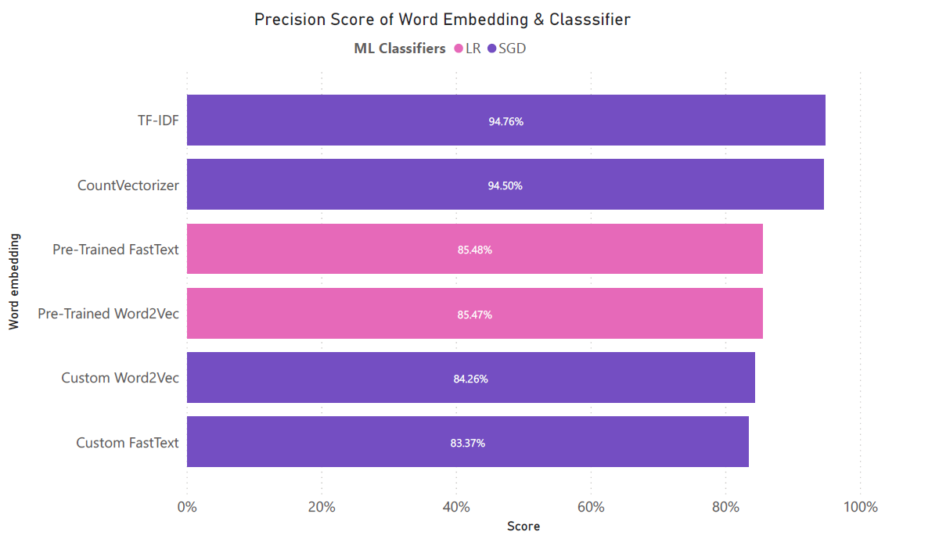
Comparison
Discussion 1
Best Pair
Fig 4. Embedding & Classifier pair

Slide 19
Comparison
Discussion 2
Custom word embeddings were used because most of the corpus words were not getting a match in pre-trained word embeddings
However, the score of custom embeddings are still poor to compare to pre-trained embeddings
Pretrained Word2Vec and Pretrained FastText have an almost similar score
TF-IDF and SGD provided best results on the news category dataset hence additional metrics used to evaluate the results
Count Vectorizer and SGD provided second best results on the news category

Slide 20
Comparison
Evaluation 1
Additional evaluation metrics for the top scorer pair of ML classifiers and word embedding in each category
Word Embedding | ML Classifier | Balanced Accuracy | Cohen Kappa Score | Matthews correlation coefficient
Count Vectorizer | SGD | 94.79% | 93.06% | 93.07%
TF IDF Vectorizer | SGD | 94.85% | 92.20% | 92.20%
Pre Trained FastText | LR | 85.25% | 80.35% | 80.35%
Pre Trained Word2Vec | LR | 84.57% | 79.44% | 79.44%
Custom FastText | SGD | 82.88% | 77.22% | 77.24%
Custom Word2Vec | SGD | 83.52% | 78.04% | 78.05%
Table 7. Additional Evaluation Metrics

Slide 21
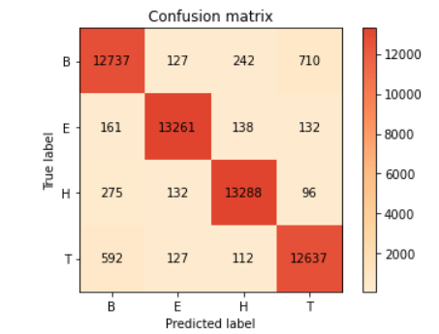
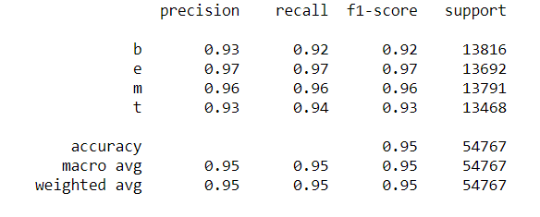
Comparison
Evaluation 2
Also the best pair in the analysis is TF-IDF and SGD classifier hence the confusion matrix and classification report is analyzed
Fig 2. Confusion Matrix
Fig 3. Classification Report

Slide 22
Error Analysis
News category prediction done on the news randomly picked from the web
Prediction based embeddings provided accurate category and scored 4/4 whereas Frequency based embeddings provided 2/4
Title | True Category | Category Predicted by Frequency based embedding | Category Predicted by Prediction based embedding
Samsung to pay Apple $539 million in iPhone patent case | Business | Science & Technology | Business
Microsoft invests in skills initiative for 25m people | Science & Technology | Business | Science & Technology
Total of 6,666 abortions carried out under new legislation last year | Health | Health | Health
12 family getaways in Ireland this summer | Entertainment | Entertainment | Entertainment
Table 6. Error Analysis

Slide 23
Comparison
[12] Used TF-IDF along with SGD to classify Bangla news articles by testing on 9,127 news articles managed 93.86% precision
This research referred techniques mentioned in [12] but performs experiments on the English news title dataset by implementing TF-IDF SGD, a lemmatizer, and n-gram to score 94.76% precision
[5] achieved 95% accuracy with supervised news classifier (SNC) method
However, this research with the balanced dataset used n-gram technique of [5] to reach 94.76% by implementing TF-IDF, SGD, a lemmatizer
[5] Akritidis, L., Fevgas, A., Bozanis, P. and Alamaniotis, M., 2019, July. A Self-Pruning Classification Model for News. In 2019 10th International Conference on Information, Intelligence, Systems, and Applications (IISA) (pp. 1-6). IEEE.
[12] Kabir, F., Siddique, S., Kotwal, M.R.A. and Huda, M.N., 2015, March. Bangla text document categorization using stochastic gradient descent (sgd) classifier. In 2015 International Conference on Cognitive Computing and Information Processing (CCIP) (pp. 1-4).
Notes:
Explain one or two dimension like:
Volume- More volume more important
Security- If data is more secured it must be important.
Eg. A,b,c datasets using 8 dimension my tool can say which dataset is more valued.

Slide 24
Conclusion
Frequency-based embeddings provided better results than prediction based embeddings
TF-IDF and SGD classifier are the best pair to obtain 94.76% precision and 94.85% balanced accuracy
ML trained models performed well for the news aggregator dataset when combined with frequency-based embedding
Can say that prediction based embeddings not performed well than frequency-based embeddings due to below reason
Most of the words were unencountered in pre trained word embeddings
Small size of the corpus is also one of the reason

Slide 25
Lessons Learned
Text categorization using NLP techniques
Use of various kind of machine learning(ML) classifiers
Finding best pair of word embedding and ML classifier
Tools & Scripting languages such as Python, PowerBI
Report writing techniques and use of citations at appropriate places

Slide 26
Future Enhancements
More data for accurate predictions
Efficient categorization of unseen news articles
Solution needs to be found for unseen news articles that don’t belong to any of the categories present in the dataset
Model shouldn't categorize unseen news titles in one of the categories of the dataset

Slide 27
References
[1] Mikolov, T., Chen, K., Corrado, G., and Dean, J., 2013. Efficient estimation of word representations in vector space. arXiv preprint arXiv:1301.3781.
[2] Asy'arie, A.D. and Pribadi, A.W., 2009, December. Automatic news articles classification in the Indonesian language by using naive bayes classifier method. In Proceedings of the 11th International Conference on Information Integration and Web-based Applications & Services (pp. 658-662).
[3] Rahmawati, D. and Khodra, M.L., 2015, August. Automatic multi-label classification for Indonesian news articles. In the 2015
10 2nd International Conference on Advanced Informatics: Concepts, Theory and Applications (ICAICTA) (pp. 1-6). IEEE.
[4] Rahmawati, D. and Khodra, M.L., 2016, August. Word2vec semantic representation in multilabel classification for Indonesian news articles. In 2016 International Conference On Advanced Informatics: Concepts, Theory And Application (ICAICTA) (pp. 1-6). IEEE.
[5] Akritidis, L., Fevgas, A., Bozanis, P. and Alamaniotis, M., 2019, July. A Self-Pruning Classification Model for News. In 2019 10th International Conference on Information, Intelligence, Systems, and Applications (IISA) (pp. 1-6). IEEE.
[6] Bogery, R., Al Babtain, N., Aslam, N., Alkabour, N., Al Hashim, Y. and Khan, I.U., Automatic Semantic Categorization of News Headlines using Ensemble Machine Learning: A Comparative Study.
[7] Al-Tahrawi, M.M., 2015. Arabic text categorization using logistic regression. IJ Intelligent System and Applications, 6, pp.71-78.
[8] X. Yang, C. Macdonald, and I. Ounis, “Using word embeddings in Twitter election classification,” Inf. Retr. J.vol. 21, no. 2–3, pp. 183–207, 2018.
[9] T. Mikolov, G. Corrado, K. Chen, and J. Dean, “Vector Space,” pp. 1–12.
[10] R. A. Pambudi, Adiwijaya, and M. S. Mubarok, “Multi-label classification of Indonesian news topics using Pseudo Nearest Neighbor Rule,” J. Phys. Conf. Ser., vol.1192, no. 1, 2019.
[11] UCI News Aggregator UCI Machine Learning Repository: News Aggregator Data Set
[12] Kabir, F., Siddique, S., Kotwal, M.R.A. and Huda, M.N., 2015, March. Bangla text document categorization using stochastic gradient descent (sgd) classifier. In 2015 International Conference on Cognitive Computing and Information Processing (CCIP) (pp. 1-4).
[13] Li, C., Zhan, G. and Li, Z., 2018, October. News text classification based on improved Bi-LSTM-CNN. In 2018 9th International Conference on Information Technology in Medicine and Education (ITME) (pp. 890-893). IEEE.
[14] Stein, R.A., Jaques, P.A. and Valiati, J.F., 2019. An analysis of hierarchical text classification using word embeddings. Information Sciences, 471, pp.216-232.
[15] Bojanowski, Piotr and Grave, Edouard and Joulin, Armand and Mikolov, Tomas. Enriching Word Vectors with Subword Information. arXiv preprint arXiv:1607.04606
[16] Wikipedia. (2020). Word embedding. [online] Available at: https://en.wikipedia.org/wiki/Word_embedding.
[17] Bogery, R., Al Babtain, N., Aslam, N., Alkabour, N., Al Hashim, Y. and Khan, I.U., Automatic Semantic Categorization of News Headlines using Ensemble Machine Learning: A Comparative Study.
[18] Mohammad Alshaer. An Efficient Framework for Processing and Analyzing Unstructured Text to Discover Delivery Delay and Optimization of Route Planning in Realtime. Data Structures and Algorithms [cs.DS]. Université de Lyon; Université Libanaise, école doctorale des sciences et technologies, 2019. English. ffNNT : 2019LYSE1105ff. fftel-02310852f
[19] Ng, Andrew. “Machine Learning and AI via Brain simulations”. Stanford University. https://ai.stanford.edu/~ang/slides/DeepLearning-Mar2013.pptx
[20] J. Cohen (1960). “A coefficient of agreement for nominal scales”. Educational and Psychological Measurement20(1):37-46. doi:10.1177/001316446002000104.
[21] Jurman, G., Riccadonna, S. and Furlanello, C., 2012. A comparison of MCC and CEN error measures in multi-class prediction. PloS one, 7(8), p.e41882.
[22] Sokolova, M., Japkowicz, N. and Szpakowicz, S., 2006, December. Beyond accuracy, F-score and ROC: a family of discriminant measures for performance evaluation. In Australasian joint conference on artificial intelligence (pp. 1015-1021). Springer, Berlin, Heidelberg.
[23] PhD, J. B. (2019, August 7). How to Develop Word Embeddings in Python with Gensim. Retrieved from machinelearningmastery: https://machinelearningmastery.com/develop-word-embeddings-python-gensim/

Slide 28
Thank You !!!

